Slide 1
Native performance and memory profiling
AppJS 2026
Notes:
This workshop goes one layer below JavaScript, into the native code that React Native sits on top of. On iOS that means Swift, and on Android it means Kotlin. Every problem covered here lives on the native side, which is exactly why none of it shows up in the JavaScript tools most React Native developers already use.
It is built for React Native developers, not for native specialists. It does not assume you have ever shipped a Swift or Kotlin module. The point is not to make you fluent in either language but to make the native layer legible, so that when a performance or memory problem hides there you know which tool to open and how to read what it shows you. Reassuringly, every bug in this deck has a small, often one-line fix once it has been located.
The shape is always the same. First a short tour of the theory and the tool, then a live demo of the bug and its fix, then hands-on time to reproduce it yourself.
Every stage of fixing the app is captured as a git branch, from native-performance-00 through native-performance-06. The 00 branch is the starting point with all the bugs in place, and each later branch carries the deck forward one fix at a time, so you can check out any branch to land exactly at that step or to compare the code before and after a change.
Further reading: React Native architecture overview at reactnative.dev/architecture/landing-page

Slide 2
What we will do today
Two blocks: I. Performance, II. Memory (a short theory intro opens each)
Android performance issue (UI thread)
iOS performance issue (UI thread)
iOS: growing memory allocations
Android: growing memory allocations
One iOS-specific memory leak (retain cycle)
An Android tool that makes leak hunting easy (LeakCanary)
Notes:
The day is split into two blocks. The first is performance, the second is memory. Each block opens with a short piece of platform theory and then moves into a live demo, so the concept and the tool always arrive together.
There are six demos in total. A main-thread (UI thread) performance issue on Android, then the same class of issue on iOS, then a growing memory allocation problem on iOS, the same problem on Android, a single iOS retain cycle, and finally LeakCanary catching a listener leak on Android.
It is worth stating plainly why the work is native at all. None of these bugs surface in JavaScript tooling such as React DevTools or the Hermes profiler. They live below that layer, so the only way to see them is to use the platform profilers. The slides are a map. The real territory is the tools.

Slide 3
Block I: Performance

Slide 4
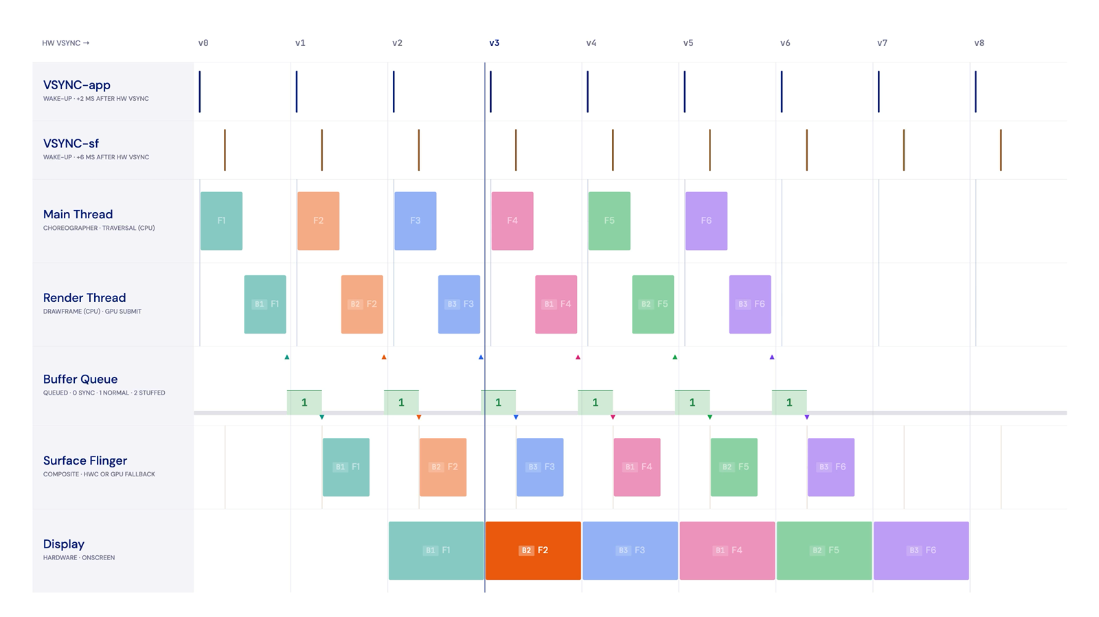
Android render loop: healthy
Notes:
A healthy Android frame reaches the screen across two vsync intervals. In the first interval the app produces the frame, and in the second interval the system compositor puts it on screen.
Producing the frame is itself two parts that share one vsync budget. On the main thread, Choreographer runs and records a DisplayList. A DisplayList describes what to draw rather than painting any pixels. It then hands off to the RenderThread, which runs in the same vsync right after the main thread and turns the DisplayList into GPU commands. The two are decoupled across frames, so the RenderThread can be finishing frame N while the main thread already starts frame N plus one.
In the next vsync, SurfaceFlinger composites every visible surface into a single output, using hardware overlays where it can and falling back to the GPU when it cannot. When everything is healthy, two buffers rotate and a frame takes roughly two vsyncs to reach the display, at a steady cadence with nothing dropped. This is the direct counterpart of double buffering on iOS.
At 60 Hz each vsync is about 16.7 milliseconds. The app signal and the compositor signal are deliberately offset from each other so the producer always stays ahead of the consumer. A third buffer exists but sits idle while things are healthy.
Further reading: Android graphics architecture at source.android.com/docs/core/graphics/architecture

Slide 5
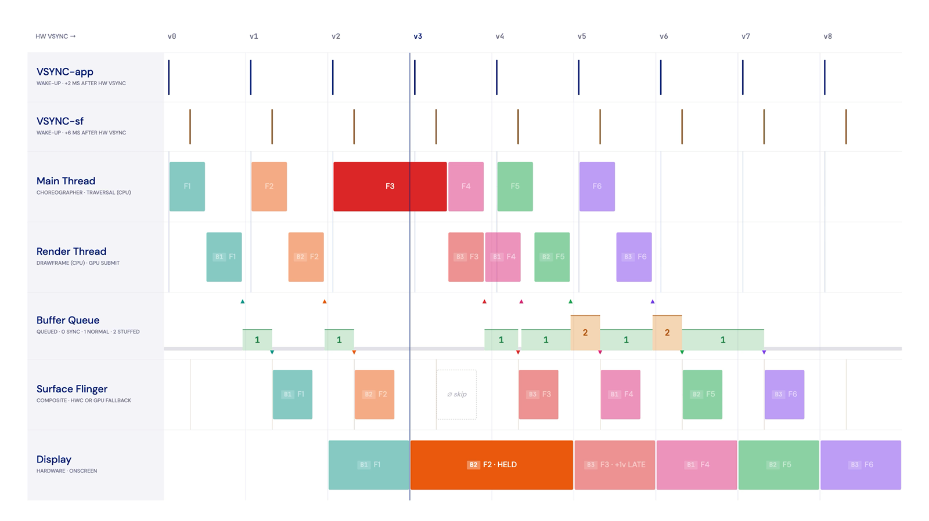
Android render loop: main thread jank
Notes:
This is the failure that the rest of the performance block hunts down. The main thread runs longer than its single vsync budget. Because the main thread is serial, the next frame cannot start on time. One frame is missed, the previous frame is held on screen for an extra vsync, and the result is a visible stutter with the new frame arriving late.
The important point is that buffering cannot rescue this. A third buffer helps only when there is independent work ready to swap in. Serial main-thread work has nothing to swap in, so triple buffering does not help at all. The same rule holds on iOS, where a commit hitch caused by main-thread overrun is equally unrescuable.
What you are seeing is a late or held frame, which is a stutter. That is different from a true dropped frame, where a newer buffer wins at the compositor and an older one never shows. The bug in the demos is exactly this shape: heavy computation sitting on the main thread.

Slide 6
Perfetto: getting familiar with the tools
Notes:
Perfetto is the system tracing tool for Android. Before using it to hunt a bug it pays to learn to read it on a healthy trace, because every row in Perfetto maps onto a stage of the render loop described earlier.
You open ui.perfetto.dev in a browser, connect the device over USB with the app in the foreground, and record a short trace during a calm interaction such as a slow scroll with nothing render-heavy on screen. The rows worth pinning and naming are the Expected and Actual frame timelines for the app, the main thread with its CPU state and flame graph, the RenderThread with the same, the SurfaceFlinger timelines, and the queued buffer track that reveals whether double or triple buffering is in play. The two offset vsync signals for the app and the compositor are visible on the timeline as well.
A useful detail when reading it: click a single frame and Perfetto draws a link to its corresponding SurfaceFlinger frame, which makes the pipeline visible as a live picture rather than an abstract diagram. If Metro disconnects during all of this, restoring the port with adb reverse tcp:8081 tcp:8081 brings it back.
Further reading: Perfetto documentation at perfetto.dev/docs

Slide 7
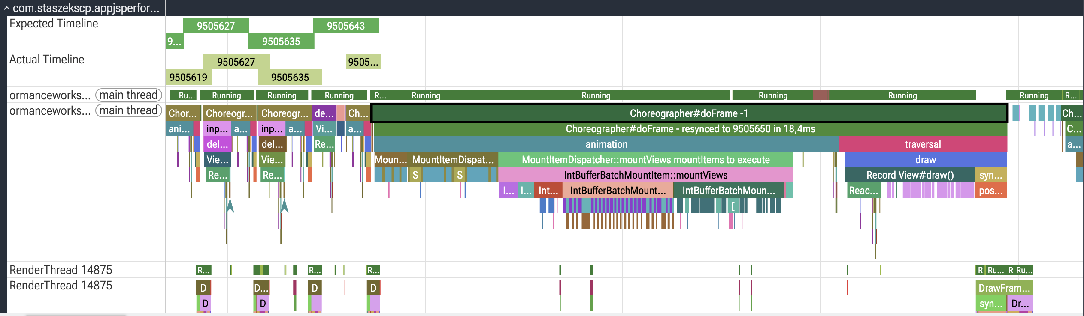
Frame resync: TOKEN = -1
Notes:
Every frame carries a token, which is its predicted present vsync. The Frame Timeline uses that token to flag when a frame missed its predicted slot.
A token of -1 means the frame entered doFrame with no valid predicted token at all. That happens because it started after its predicted vsync had already passed, in other words out of cadence, so Choreographer re-syncs it to the current live vsync. In a trace this shows up as the heavy frame, labelled something like doFrame -1 resynced in 18.4 milliseconds. The duration above one vsync confirms it overran.
The frame still presents. It simply presents late. A re-sync is a late present, not a dropped frame. A genuine drop is a different event, where a newer ready buffer wins at SurfaceFlinger and the older frame never shows at all. Here the typical cause of the -1 is that the main thread was busy with the preceding work, so a heavy mount and traversal woke after its predicted slot was already gone.

Slide 8
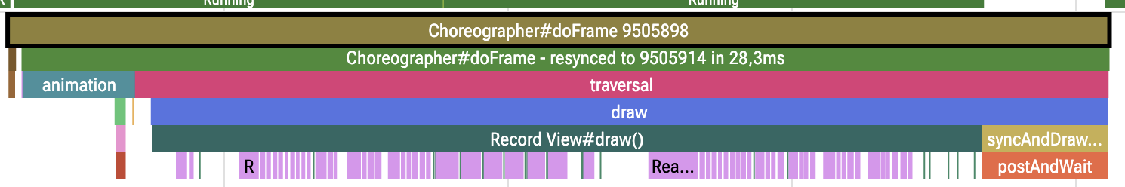
Frame resync: TOKEN > 0
Notes:
This is the companion case to the -1 token. Here the token is a positive number N, which means the frame did start with a valid predicted slot and entered on time. The problem is that it then ran or woke late, so Choreographer re-aligns it to a later vsync, N plus K, skipping K beats. In the trace it reads as doFrame N resynced to N plus K.
As with the -1 case, this is a late present. The frame still reaches the screen, just at a later vsync than predicted. The difference between the two cases is only where the frame started. With a positive token it had a predicted slot and jumped forward from it. With -1 it had no valid token at entry and acquired one. Both outcomes are a late present to a later slot, which is not the same as a true dropped frame where a newer buffer wins at the compositor and the frame never shows.

Slide 9
simpleperf: from ART frames to Kotlin names
Notes:
The jank is real, but plain sampling will not name it. Kotlin in the workshop app runs interpreted, so a sampling profiler sees the Android runtime frames, things like ExecuteSwitchImplCpp, rather than the Kotlin method you actually wrote. To get readable names you need simpleperf, which folds the runtime frames together and symbolicates the Kotlin underneath.
In practice you enable the heavy state in the app, record, and watch the Frame Timeline go red with large gaps on the main thread. The thread state during those gaps is Running, which tells you the CPU is genuinely busy rather than waiting on something. Plain sampling at this point is unhelpful because the stack is runtime C++. Running the simpleperf helper changes that. It produces a profile you can open either in the Firefox profiler or as the simpleperf HTML report, and both point at the same hotspot. The helper scripts that run simpleperf and generate these reports live in the scripts folder of the repository, so you do not have to assemble the command by hand. In this app that hotspot is the palette quantize and histogram work running on the main thread.
A couple of practical notes. The kernel setting security.perf_harden defaults to 1 and blocks perf sampling, so the helper script handles that. The report scripts also need a recent enough Python. You could ahead-of-time compile to get Kotlin names from plain sampling, but the readability is still poor, which is why traces or simpleperf are the better tools.
Further reading: simpleperf at developer.android.com/ndk/guides/simpleperf

Slide 10
Adding traces (Android)
import android.os.Trace
/*
* Sync section rules
* begin/end: same thread, paired, nested LIFO
* early return: wrap in try / finally
* name: 127 chars max
* shows: nested slices on the thread track
* capture, in Perfetto:
* > Record new trace
* > Android apps & svcs
* > Atrace userspace annotations
* > add com.staszekscp.appjsperformanceworkshop
* to "Process / package names to trace"
*/
// synchronous pair
Trace.beginSection("ImagePalette.quantize")
Trace.endSection()
// safe with early returns
Trace.beginSection("getDominantColors")
try {
// all paths, incl. return@AsyncFunction
} finally {
Trace.endSection()
}
Custom traces turn an anonymous hot stack
into named slices on the thread track,
so anyone can read the trace.
Notes:
Custom traces turn an anonymous hot stack into named slices on the thread track, so that anyone reading the trace can see what the work is without guessing. The API is android.os.Trace, and the simplest form is a synchronous pair of beginSection with a name and a matching endSection.
A few rules matter in practice. The begin and end must run on the same thread and be paired, and nested sections must close in last-in first-out order. If a code path can return early, wrap the section in a try and finally so the end always runs. Names are limited to 127 characters.
For the slices to be captured the app has to be included in the trace. In Perfetto you record a new trace, choose Android apps and services, enable atrace userspace annotations, and add the app package to the list of processes to trace. Once captured, the sections appear as nested slices directly on the thread track. This is the Android convention. On iOS the equivalent signposts render in a separate lane instead.
Further reading: android.os.Trace at developer.android.com/reference/android/os/Trace

Slide 11
Async traces (bonus)
/*
* Async section rules
* cookie pairs begin/end
* no same-thread or LIFO constraint
* use for cross-thread or overlap
* shows on its own async track
* our off-main fix uses one worker
* thread, so sync traces still work
*/
val cookie = 42 // unique id
Trace.beginAsyncSection(
"ImagePalette.asyncCompute", cookie)
// may run on another thread
Trace.endAsyncSection(
"ImagePalette.asyncCompute", cookie)
Async sections pair work by a cookie,
for intervals that cross threads
or overlap.
Notes:
Synchronous trace sections assume the work begins and ends on the same thread. When the work crosses threads or two intervals of the same name overlap, you use an asynchronous section instead. An async section pairs its begin and end by a cookie, a unique id, rather than by thread and ordering, so there is no same-thread or last-in first-out constraint. It renders on its own async track.
In the context of this workshop the async form is genuinely a bonus rather than a requirement. The off-main fix runs the whole color computation on a single worker thread, so a plain synchronous section still works. It simply moves from the main thread row to the worker thread row. The async form is only needed when an interval truly spans a hand-off, beginning on one thread and ending on another, or when same-name sections overlap in time.

Slide 12
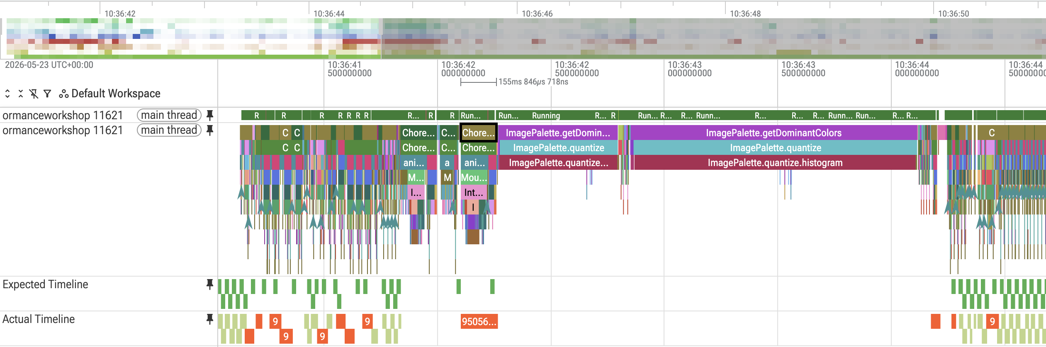
Custom traces visible
Notes:
This is what the trace looks like after the custom sections are added. The named slices now appear directly on the main thread track. The palette quantize work, and the histogram and swatch-picking nested inside it, sit exactly where the gap in rendering was. There is no more inferring the work from anonymous runtime frames, because the trace now names it. Naming the work and seeing the dropped frames in the same view is what makes the next step, moving the work off the main thread, an obvious fix rather than a guess.

Slide 13
Move compute off the main thread
Notes:
The instinct to micro-optimize the algorithm first is worth resisting. The cleaner fix is to move the computation off the main thread entirely, because computing the colors is not render work. Only displaying them is. Once the heavy computation runs elsewhere, the main thread is free to keep producing frames on cadence.
Concretely this means switching the palette computation onto a worker thread. In this app a build flag toggles the queue the Kotlin code uses, from the main queue to a default background queue. Recording Perfetto again shows the palette work sitting on a worker thread with the main thread free and the Frame Timeline green.
One honest caveat is worth keeping in mind. The background thread is still doing the same heavy work. That still costs battery and palette latency and can risk thermal throttling under sustained load. Moving the work off the render path removes the jank, but it does not remove the work. The best version of the fix, shown at the end of the performance block, is to avoid the work on the device altogether.

Slide 14
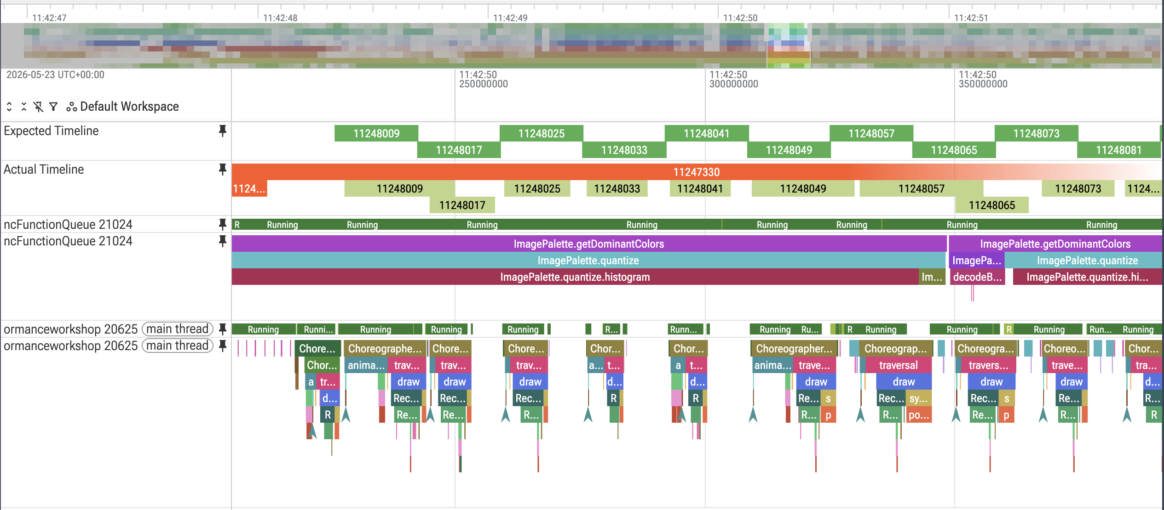
Worker-thread Perfetto
Notes:
This screenshot is the worker-thread trace after the fix. The palette computation now runs on a worker thread, the main thread is free, and the Frame Timeline is green. It is the same work as before, simply moved off the render path so it no longer blocks frame production. The next demo takes the same class of bug to iOS, where the tooling is a little friendlier because Swift is compiled and the stack names itself.

Slide 15
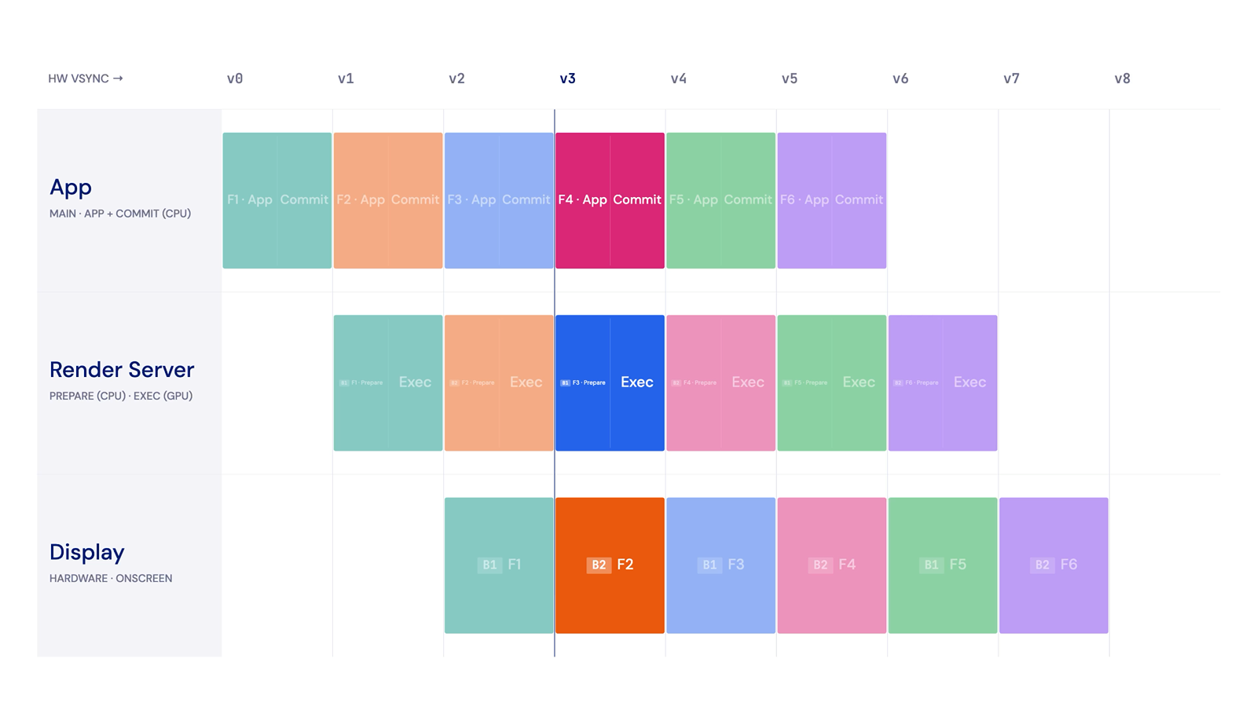
iOS render loop: healthy
Notes:
The iOS render loop is the same idea as Android with fewer parts and different names. A frame walks through three stages: App and Commit, then the render server, then Display.
App and Commit runs on the main thread. It builds the CALayer tree and commits it to the render server over interprocess communication. Like the Android main thread, it describes layers rather than drawing any pixels. The render server is a separate process that does two things, a Prepare step on the CPU that builds the render tree and an Exec step on the GPU that renders and composites. That single render server stage is the equivalent of the Android RenderThread plus SurfaceFlinger combined. Finally the Display stage scans the result out at vsync, with two buffers alternating, which is double buffering.
End to end this is about two vsyncs, the same as a healthy Android frame. One difference worth noting is that iOS does not split into offset app and compositor signals the way Android does. Instead it works to deadlines computed backward from the presentation time. The full span from begin to presentation is the frame lifetime, and that is the quantity Instruments measures.
Further reading: WWDC session Explore UI animation hitches and the render loop, developer.apple.com/videos

Slide 16
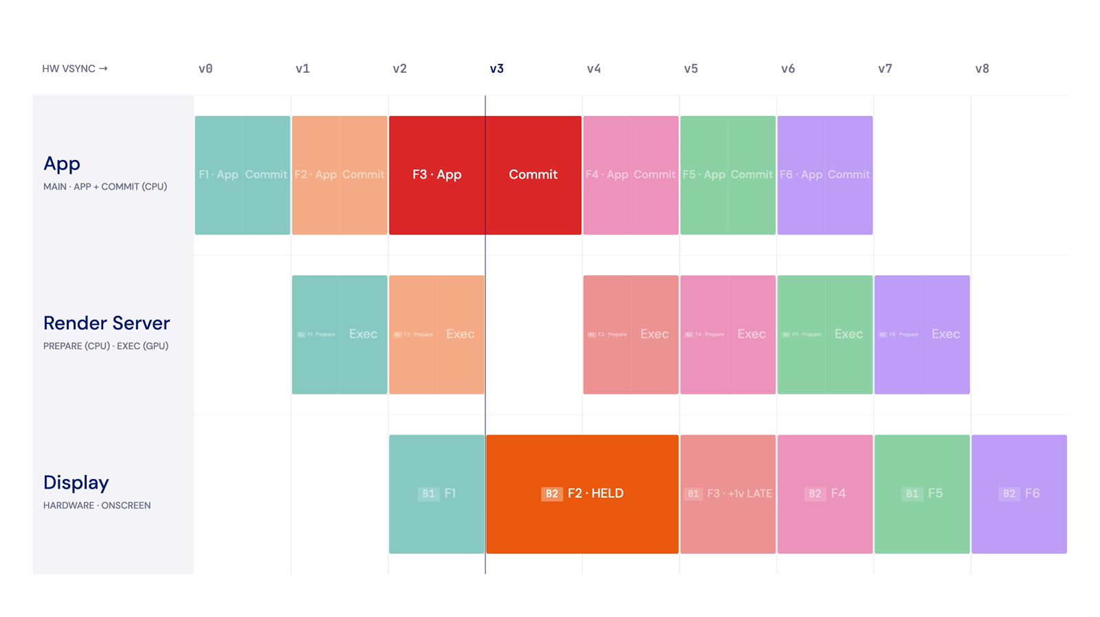
iOS render loop: main thread hitch
Notes:
Here the App and Commit stage overruns its vsync, usually because of heavy layout or other main-thread work. Because the main thread is serial, a frame is missed and the previous one stays on screen for an extra vsync, which the eye reads as a stutter. As on Android, the extra buffer cannot rescue this, because serial work has nothing independent to swap in.
It is worth stressing that this is not an iOS versus Android difference. A commit hitch drops a frame on iOS for the same reason a main-thread overrun does on Android. This is the exact bug the iOS demo goes on to find, with friendlier tooling than the Android equivalent.

Slide 17
Instruments Animation Hitches (iOS)
Notes:
This is the same main-thread bug as on Android, but on iOS the stack names itself. Swift is compiled ahead of time, so the Time Profiler shows your own functions directly, with no symbolication dance. The place the investigation lands is the palette quantize running during commit on the main thread.
The tool is the Animation Hitches template in Instruments. You start with a healthy scroll to learn the rows, the Updates, Render Server, GPU, and Frame Lifetime tracks, and tie each to a stage of the iOS pipeline. Then you reproduce the bug by triggering the heavy state and recording, at which point the Updates blocks turn red and the Hitch Time Ratio jumps. Switching to the Time Profiler and drilling the main-thread stack lands directly on the palette quantize, with readable Swift names.
The contrast with Android is the one place iOS is easier. Android needed simpleperf to name interpreted Kotlin, whereas compiled Swift is named by the sampler for free. When reading hitches it helps to think in terms of frame lifetime rather than only a single red phase.
Further reading: Instruments and the Animation Hitches template, developer.apple.com/documentation/xcode/analyzing-the-performance-of-your-app

Slide 18
Adding signposts (iOS)
import os
/*
* name: StaticString literal
* beginInterval -> token -> endInterval
* early returns: use defer
*/
private static let signposter = OSSignposter(
logHandle: OSLog(subsystem: "ImagePalette",
category: .pointsOfInterest))
// defer at the top covers every exit path
func getColors(_ img: Image) -> [Int] {
let s = signposter.beginInterval("getColors")
defer { signposter.endInterval("getColors", s) }
guard let rgba = extract(img) else { return [] }
// ... more of the function body ...
return quantize(rgba) // defer fires here too
}
// OPTIONAL: show values, else n/a -> n/a in
// Instruments. Pass an interpolated message
// (name stays a literal, values go in the msg):
let s = signposter.beginInterval(
"getColors", "pixels: \(count)")
signposter.endInterval(
"getColors", s, "colors: \(out.count)")
Signposts mark the work in a separate
Points of Interest lane, not on the
thread row like Android atrace.
Notes:
Signposts are the iOS way to mark your own work as named intervals in Instruments, so the hot work is obvious next to the hitch. You import os, create a single OSSignposter on the points-of-interest category, and wrap the work in beginInterval and endInterval.
A few rules tend to bite. The interval name has to be a StaticString, a compile-time literal. beginInterval returns a state token that you must pass back into endInterval. For early returns, guards, or throws, use defer at the top of the function so the end always fires no matter which path exits, which is the Swift analogue of try and finally.
The key difference from Android is where signposts render. They appear in a separate Points of Interest lane rather than on the thread row, so you read them by time-aligning them with the hitch. There is no API to draw a custom span onto the sampled thread row. On iOS you do not actually need one, because the Time Profiler already names compiled Swift on the thread row for free. So the single job that atrace does on Android is split in two on iOS, signposts for named intervals in their lane and the Time Profiler for named functions on the thread row. Both Animation Hitches and the Time Profiler capture signposts automatically, with no per-app configuration. For work that crosses threads or overlaps, you can pass an explicit id from makeSignpostID, which drops the same-thread and one-at-a-time requirement, the Swift counterpart of the Android async cookie.
Further reading: OSSignposter at developer.apple.com/documentation/os/ossignposter

Slide 19
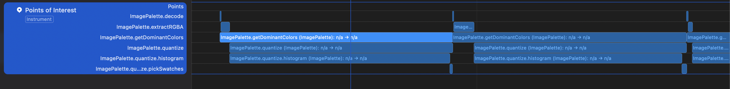
OSSignposter in Points of Interest
Notes:
This screenshot shows the signposts in place. The intervals added in code appear as named entries in the Points of Interest lane. Time-aligning them with the main thread makes the point clear: the quantize interval sits right under the hitch on the Updates track, which identifies exactly the work to move. As noted before, they live in a separate lane rather than on the thread row, which is the opposite of how Android atrace slices render.

Slide 20
Move compute off the main thread
Notes:
The fix is the same as on Android. The palette computation is not render work, so it can move off the main thread. On iOS that means removing the call that pins the work to the main queue, so the color computation no longer runs during commit.
After removing the main-queue hop and recording Animation Hitches again, the Updates track is clean, the Hitch Time Ratio drops, and the quantize interval is now off the main thread. The same honest caveat as Android applies. The CPU still does the work, just off the render path. The best fix of all, precomputing the result so the device does no work at all, is the final step of the performance block.

Slide 21
Precomputed branch (best fix: no work on device)
Notes:
Both platforms now run the palette computation on a background worker, which removes the jank. This branch goes one step further to the best possible fix. The backend computes the palette for each post and ships it inside the post metadata, so the feed never calls the native module again. Scrolling the feed is instant because there is no native call and no computation on the device at all.
The takeaway is simple and general. The fastest computation is the one you never run on the device. Moving heavy work to a worker thread is a good fix, but moving it off the device entirely is a better one when the result can be precomputed. That closes the performance block, and the memory block follows.

Slide 22
Block II: Memory

Slide 23
A hypothetical story
After the latest release, Sentry shows more and more OOM crashes.
We diff the versions: the one big change is a new native module (Engagement, it tracks user activity).
But it is a dependency, not our code (let's assume it for a while): complex, hard to reason about from source alone.
How do we find what is leaking, or at least get close?
The platform memory tools narrow it down. We start on iOS.
Notes:
This frames the memory block as a realistic story. After the latest release, the crash reporter shows a steadily rising number of out-of-memory crashes. Diffing the versions, the one large change is a new native module, here called Engagement, which tracks user activity.
The complication is that it is a dependency rather than first-party code. Assume for the moment that you cannot simply read the fix out of the source, because the module is complex and hard to reason about from source alone. The crash is also subtle. There is no immediate failure. The app dies only after a long session, so a pure code review is slow and you need a way to narrow down where to look.
The platform memory tools are what narrow it down. They tell you what is leaking, or at least get you close enough that a targeted code review finishes the job. The investigation starts on iOS, but before touching the tools the block covers how memory works on each platform, because the tools only make sense once you understand the underlying model.

Slide 24
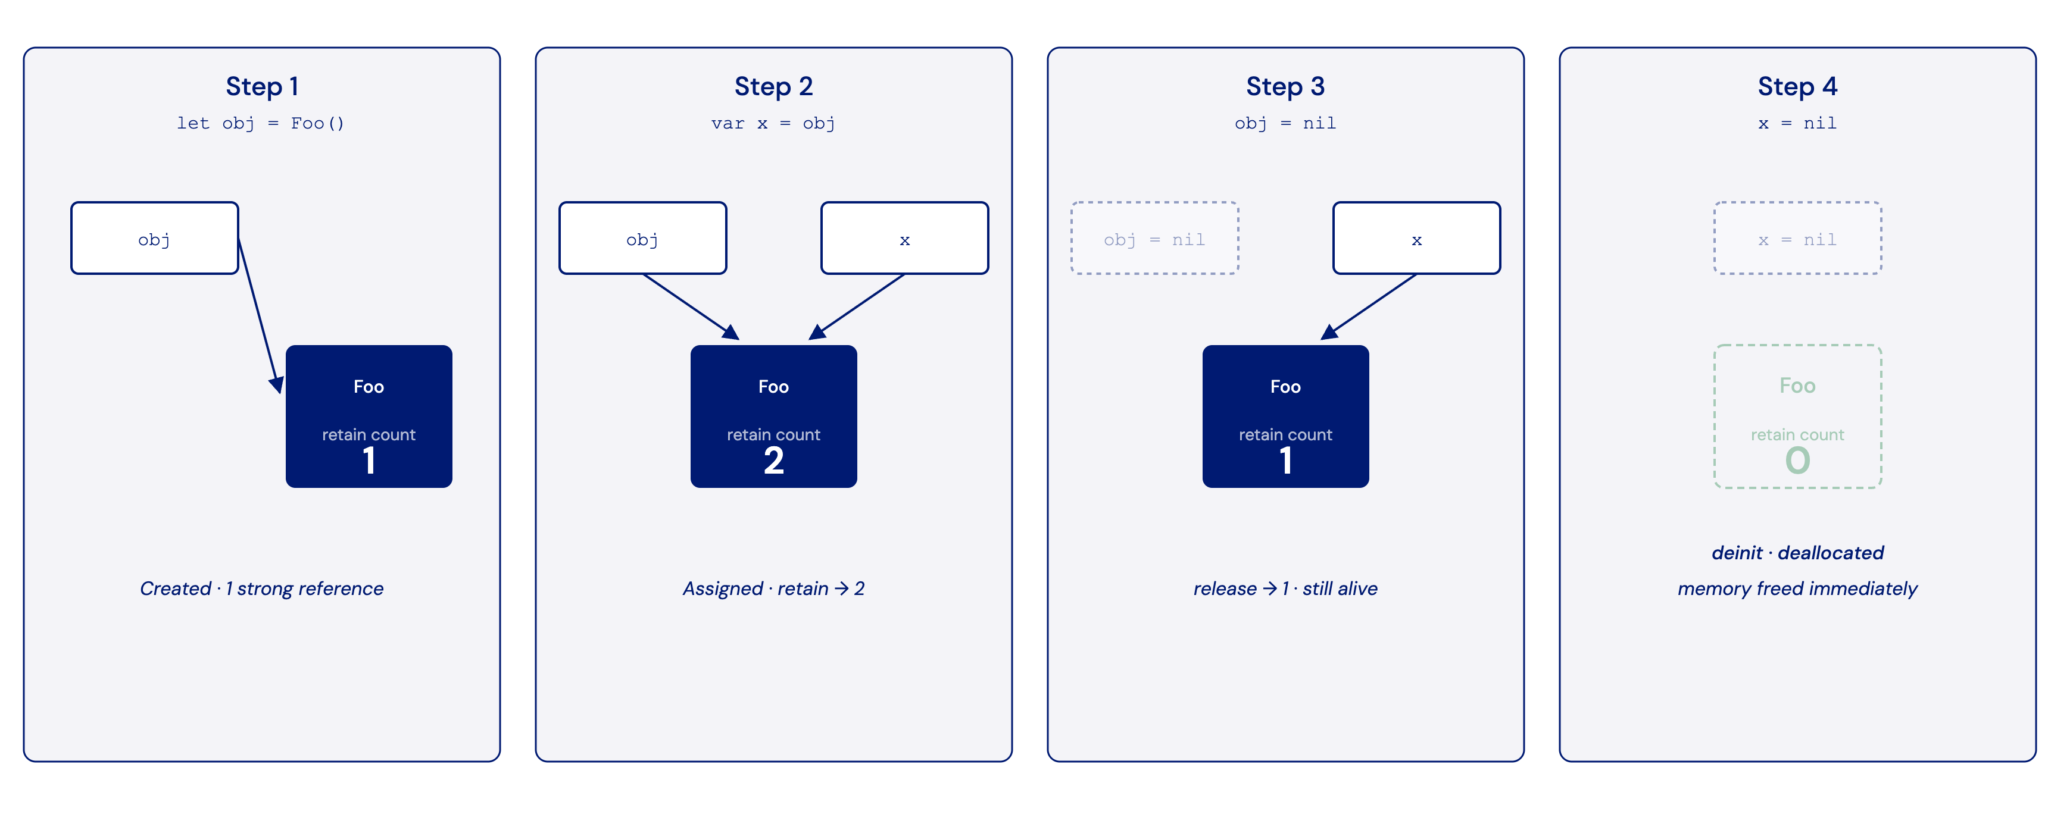
ARC: retain count
Notes:
iOS has no garbage collector. Memory is managed by Automatic Reference Counting, ARC, and every object carries a retain count. Each strong reference to an object adds one to that count, which is a retain, and dropping a strong reference subtracts one, which is a release. The moment the count reaches zero the object is deinitialized and its memory is freed immediately.
The defining property is that this is deterministic. An object is freed at the exact point its last strong reference goes away, not at some later collection pass. ARC inserts the retain and release calls at compile time, so there is no collector pause. The one thing reference counting cannot do on its own is reclaim a cycle of objects that hold each other, which is the subject two slides on.
Further reading: Automatic Reference Counting in the Swift book, docs.swift.org/swift-book/documentation/the-swift-programming-language/automaticreferencecounting

Slide 25
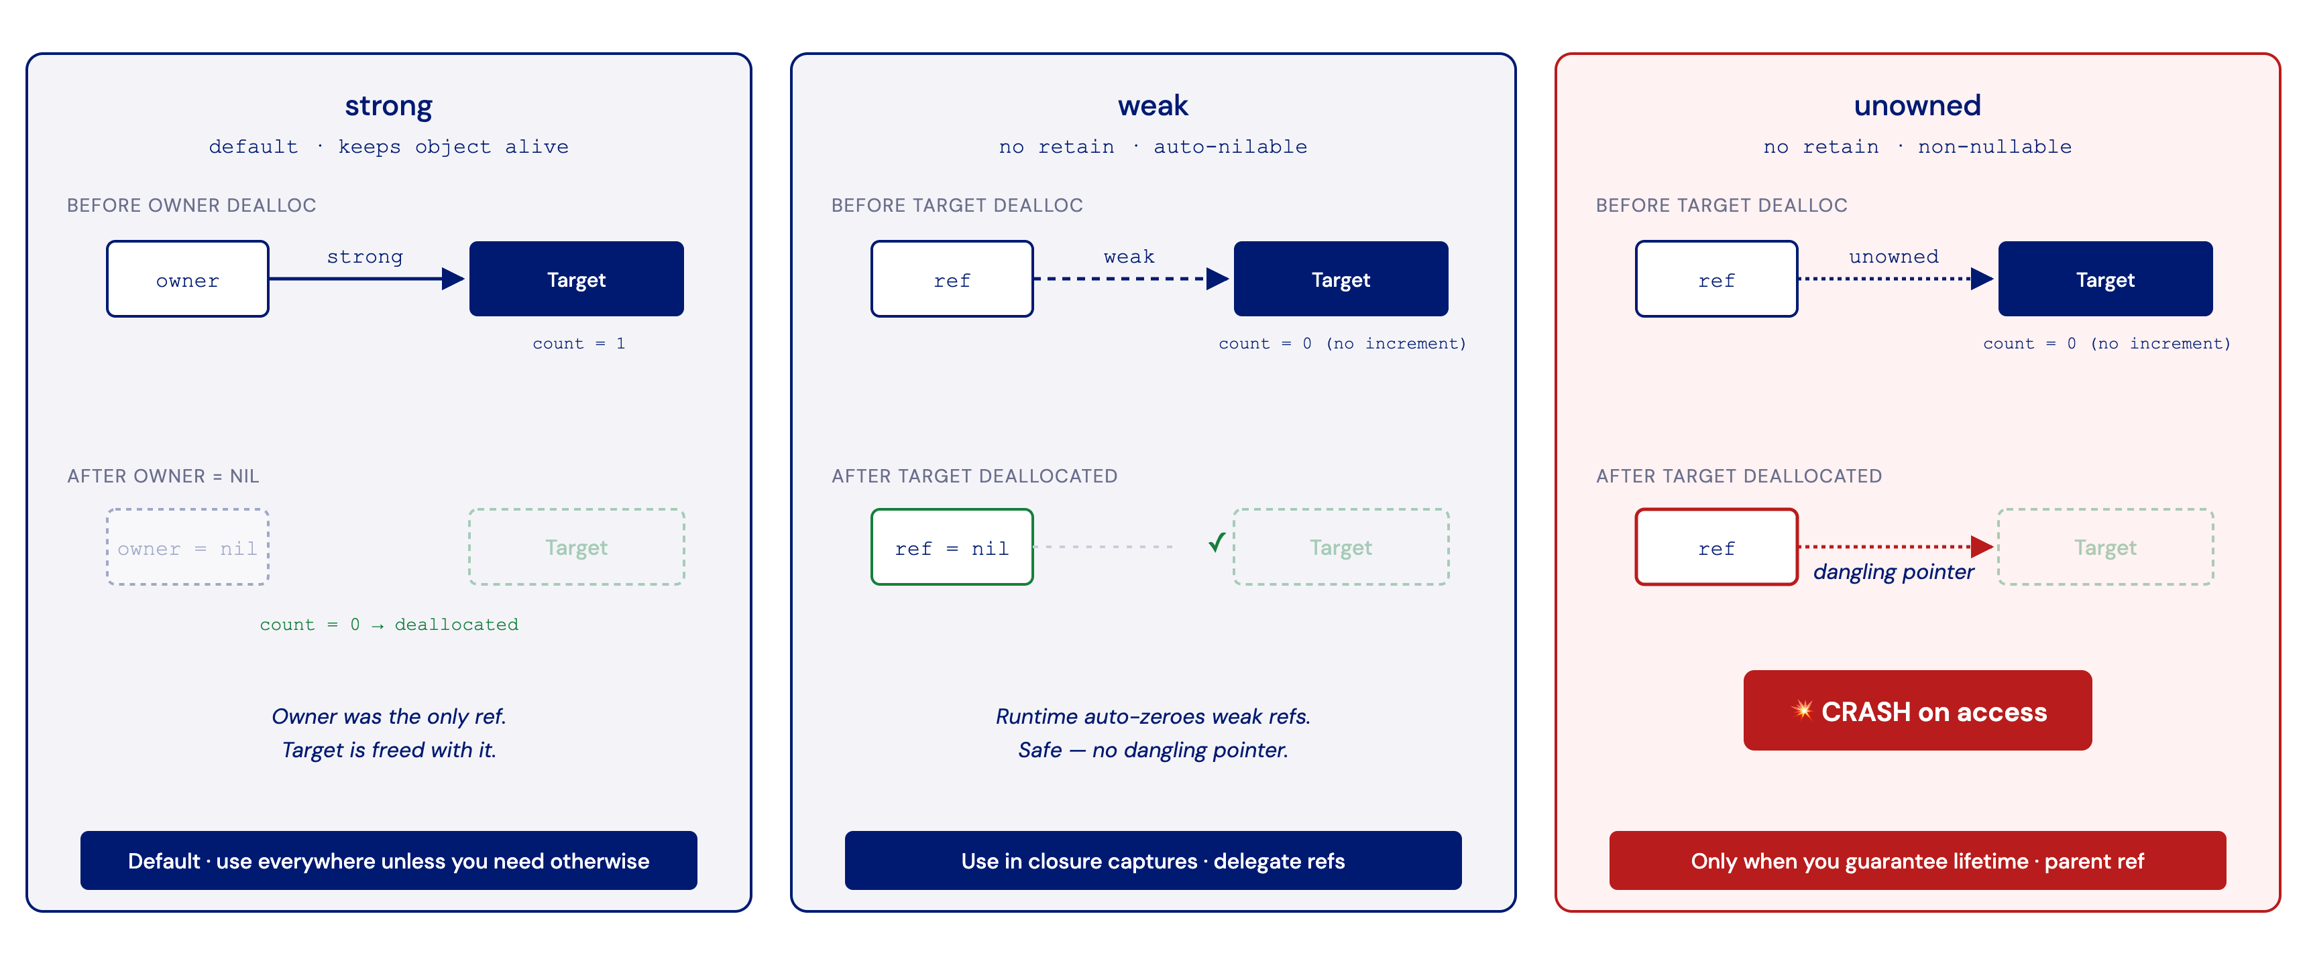
Strong, weak, unowned
Notes:
Swift has three kinds of reference, and the difference between them is what causes and what prevents leaks.
A strong reference is the default. It keeps the object alive by adding to its retain count, and you use it everywhere unless you have a specific reason not to. A weak reference does not retain the object, and the runtime automatically sets it to nil when the target is deallocated, which means it can never become a dangling pointer. Because it can become nil, a weak reference must be Optional. It is the right choice for closure captures and delegate references. An unowned reference also does not retain, but it is non-optional and is not zeroed when the target goes away. Accessing it after the target has been freed is a dangling pointer and crashes. You use unowned only when you can guarantee the target outlives the reference.
The trade-off is worth memorizing. A wrong unowned crashes, and a wrong strong leaks. When in doubt, prefer weak.
Further reading: Resolving Strong Reference Cycles Between Class Instances, docs.swift.org/swift-book/documentation/the-swift-programming-language/automaticreferencecounting

Slide 26
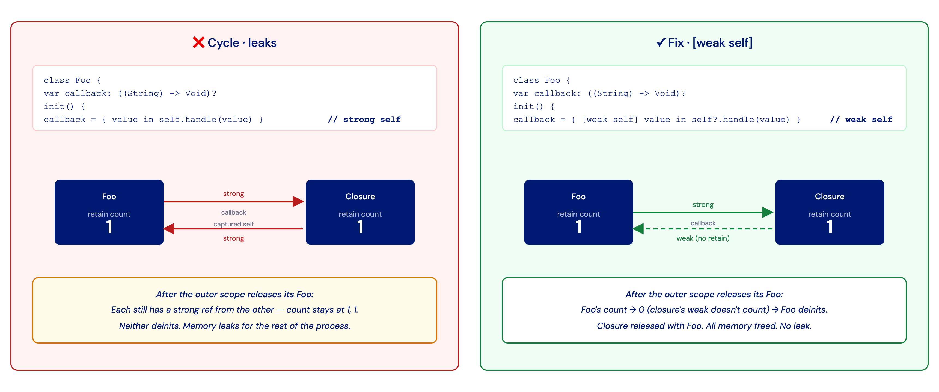
Retain cycle (and the fix)
Notes:
A retain cycle is the classic way reference counting leaks. Two objects hold strong references to each other. A common shape is an object that stores a closure where the closure captures self strongly. When the surrounding scope releases the object, each member of the cycle is still strongly referenced by the other, so both counts stay at one. Neither reaches zero, neither is deinitialized, and the memory is leaked for the rest of the process.
ARC cannot collect this on its own, because there is no garbage collector tracing reachability. The fix is to break one edge of the cycle by making it weak or unowned, most often with weak self inside the closure. This is exactly the second leak the iOS demo hunts later, where the Engagement module stores an onSample closure. Marking the capture weak self means it no longer counts toward the module, so the module can reach zero and deinitialize. It is worth contrasting with Android, where a tracing garbage collector does reclaim unreachable cycles, so this specific cycle would not leak there.

Slide 27
Allocations: every allocation, with its callstack
Notes:
The Allocations instrument tracks every allocation the process makes, not only the managed heap but also memory-mapped files and dynamic libraries. With malloc stack logging enabled it also records who made each allocation, by callstack. This is the iOS answer to the question who allocated this, which later contrasts with the Android heap dump that answers who retains this.
For this particular bug the Leaks instrument would report nothing, because the problem is not a retain cycle. It is a buffer that grows forever while remaining perfectly reachable. That is why Allocations rather than Leaks is the right tool here. In use you record with reference counts enabled and read the call tree, which attributes allocated bytes per subtree. To focus on this one module, switch to the Statistics section of the instrument and type the word Engagement into its filter field. That narrows the list to allocations whose type or callstack contains it, so you isolate the module's own objects instead of scanning the whole heap. The telling signature is an Engagement sample count that climbs and never comes back down.
One prerequisite matters. Malloc stack logging must be enabled in the scheme before launch, covered on the next slide. Without it you see the allocations but not the code that created them.
Further reading: Instruments help, developer.apple.com/documentation/xcode/gathering-information-about-memory-use

Slide 28
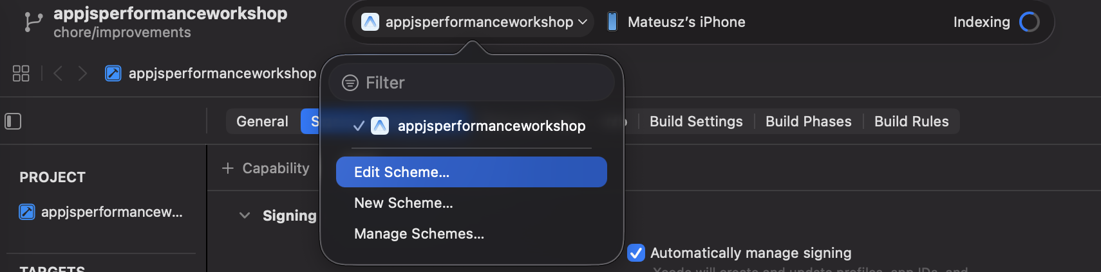
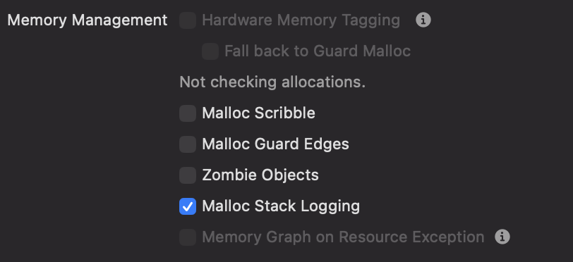
Prerequisite: Malloc Stack Logging
Notes:
This is the prerequisite for getting useful callstacks out of Allocations. Without malloc stack logging the instrument shows the allocations but not the code that made them, which is the part you actually need.
You enable it from the scheme. Click the scheme name in the top bar, choose Edit Scheme, then Run, then the Diagnostics tab, and under Memory Management turn on Malloc Stack Logging. The critical detail is that it has to be on at launch. Attaching to an already-running app gives a call stack limit reached message and no callstacks. With it enabled from launch you can record in Allocations and hunt the growing buffer with full backtraces.

Slide 29
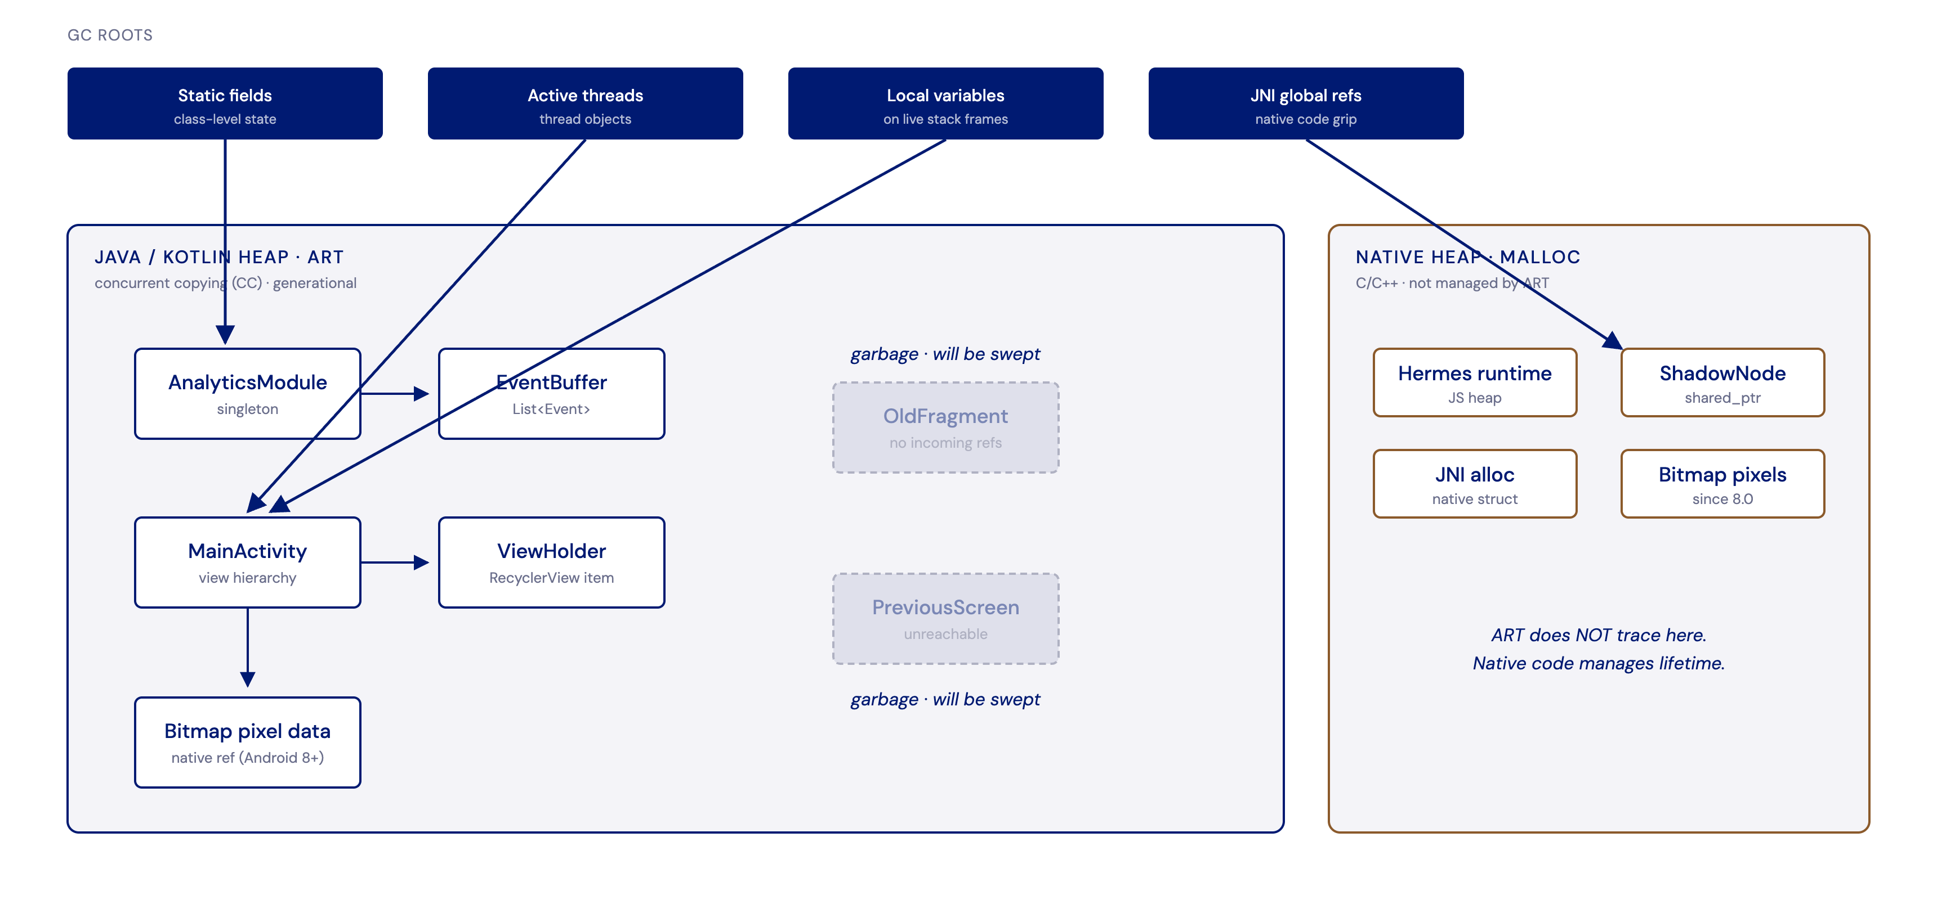
GC roots and the two heaps
Notes:
The same growing-buffer bug now moves to Android, where memory is freed in a completely different way. Android runs on the ART runtime, which uses a garbage collector. The default since Android 8 is a concurrent copying, generational collector. Nothing is freed by counting references. Instead the collector periodically traces what is still reachable.
It starts from a set of GC roots and keeps alive everything reachable from them. Everything else is garbage. There are four kinds of root worth knowing. Static fields hold class-level state and live as long as the class is loaded, which is usually the whole app, so a static holding an Activity or Context is a classic leak. Active threads are themselves roots, and a running thread keeps alive everything it references until it finishes. Local variables on live stack frames are roots while their method is still executing, because the running code can still use them, and they stop being roots once the method returns. JNI global references are handles that native code holds on a Java object, and they count as roots because ART cannot see into native code.
A separate native heap, managed by malloc rather than ART, holds things like the Hermes JavaScript heap, C++ ShadowNodes, JNI allocations, and bitmap pixels since Android 8. ART does not trace there. Native code manages that lifetime. One consequence that matters for the rest of the block is that a retain cycle is not a leak on Android, because the collector reclaims unreachable cycles. An Android leak is instead an object still reachable from a root but kept far longer than it should be, such as a static holding a destroyed Activity.
Further reading: Manage your app's memory, developer.android.com/topic/performance/memory-overview

Slide 30
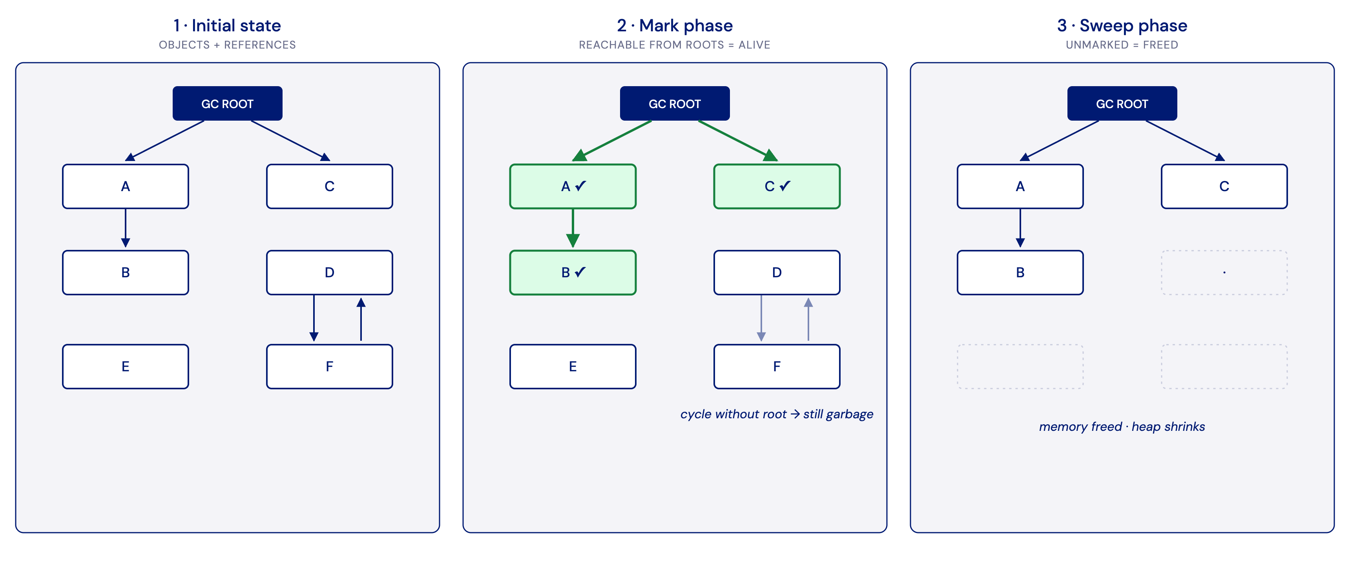
Mark and sweep
Notes:
Mark and sweep is the reachability idea at the heart of tracing collection, in three steps. Start from the roots. Mark everything reachable from them as alive. Then sweep, which means free everything left unmarked.
The key consequence is about cycles. A cycle of objects that has no path from any root stays unmarked, so it is collected. That single fact is why Android does not leak the kind of reference cycle that iOS does. The reachability model simply does not care whether objects point at each other, only whether a root can reach them.
A note on accuracy. ART since Android 8 uses Concurrent Copying, which is concurrent, moving, and generational rather than literal mark and sweep, and older ART used a concurrent mark-sweep collector. Mark and sweep here is the concept, not the exact algorithm. Generational means most objects die young, so the young generation is collected often and the old generation rarely.
Further reading: ART and Dalvik, source.android.com/docs/core/runtime

Slide 31
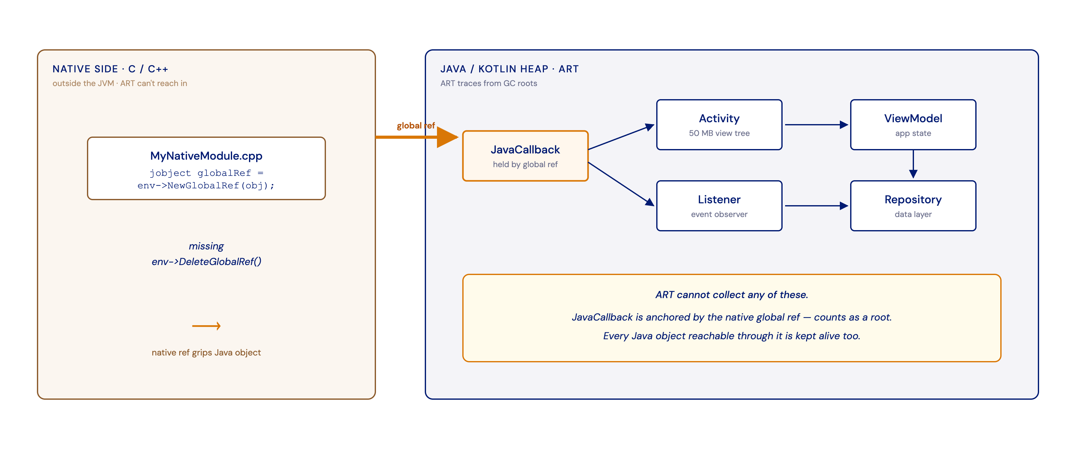
JNI global refs pin Java objects
Notes:
This slide isolates one specific root because it is where native-side leaks hide. Native C and C++ code lives outside the managed runtime, and ART cannot trace into it. When native code calls NewGlobalRef it creates a handle that grips a Java object, and that handle counts as a GC root.
The leak follows directly. If the native side forgets to call DeleteGlobalRef, the Java object it gripped can never be collected, and neither can anything reachable through it, which can be an entire Activity and its view tree. JNI local references are released automatically when the native call returns, so they do not cause this problem. Global references are the ones that leak, because their lifetime is manual. This is the bridge to the growing-buffer demo, because a native module holding Java or Swift state is exactly the kind of place this leak lives.
Further reading: JNI tips, developer.android.com/training/articles/perf-jni

Slide 32
Perfetto heap dumps: who retains it
Notes:
A heap dump is a snapshot of the entire Java and Kotlin heap as a graph. It captures every object and, crucially, who points to whom. You query it with SQL over tables such as heap_graph_object and heap_graph_class, including a retained_size column. Take dumps periodically through a session and you can see what grows over time.
The kind of attribution differs from iOS in an important way. The Allocations instrument answered who allocated an object, by callstack. A heap dump answers who retains it, meaning the chain of references that keeps it alive back to a GC root. For a leak the retainer is what you need, not the allocator. Starting from a growing object you walk its incoming references upward until you reach the thing that never lets go.
In practice you check dumpsys meminfo first and watch the Java heap climb across a long session, then record a Perfetto trace with continuous Java heap dumps, then use SQL to count the suspect class per dump and watch the trend climb, and finally walk the retainer chain to the buffer that holds everything. A few practical notes. The Java heap profiler forces a collection before each dump, so whatever appears in a dump is genuinely retained rather than garbage awaiting collection. The native allocation profiler heapprofd is a different data source, and the one needed here is the Java heap graph.
Further reading: Java heap profiler, perfetto.dev/docs/data-sources/java-heap-profiler

Slide 33
Setting up heap dumps in Perfetto
ui.perfetto.dev > Record > Memory > enable Java heap dumps
In 'Names or pids of the processes to track (required)' enter com.staszekscp.appjsperformanceworkshop (exact package, empty field captures nothing)
Continuous dump every 3-5 s: a SERIES of dumps to compare, not one at the end
Long trace + big buffer: heap-dump traces get large fast
In the app: tracking ON, then repeatedly start/end post sessions by scrolling (each session appends samples to that post's buffer, never cleared)
Notes:
This is the configuration that makes continuous heap dumps work in Perfetto. You open ui.perfetto.dev, go to Record, then Memory, and enable Java heap dumps.
Two settings are easy to get wrong. In the field for the names or pids of the processes to track, enter the exact app package and double-check the spelling. An empty field captures nothing at all, the tables stay empty, and every query returns zero rows. Then set a continuous dump every few seconds, because the whole technique relies on having a series of dumps to compare over time rather than a single snapshot at the end. Heap-dump traces grow large quickly, so raise the buffer and use a long-trace or flush-to-file option if available.
The app has to be doing the leaking work while you record. Turn engagement tracking on, then scroll so that post sessions repeatedly start and end, viewing a post, leaving it, and coming back. Each session appends new samples to that post's buffer, which is never cleared, so the buffer fills fastest when many sessions start and end. Without that activity the buffer never grows and the leak appears absent. As a sanity check that the app is dumpable at all, adb shell am dumpheap on the package should produce a non-empty hprof file.
Further reading: Java heap profiler, perfetto.dev/docs/data-sources/java-heap-profiler

Slide 34
Heap dump SQL queries
-- branch: perfetto-sql-queries
-- file: heap-growth-queries.sql
-- 0 how many heap dumps?
select count(distinct graph_sample_ts) ...
-- 1 per Engagement type: first vs last
select c.name, ... as growth ...
-- 2 class instances per dump (trend)
select graph_sample_ts as ts, count(*) ...
-- 3 app-wide top growers (blind)
select c.name, ... order by growth desc ...
-- 5 who holds it (direct referrer)
select holder.name, ref.field_name ...
-- 6 who retains most (retained_size)
select c.name, sum(retained_size) ...
-- (+ 4 bytes variant, in the file)
See heap-growth-queries.sql on perfetto-sql-queries branch.
Run them in Perfetto's Query (SQL) tab.
Notes:
With a series of heap dumps recorded, you compare them in Perfetto's Query SQL tab. The signature of a leak is monotonic growth that survives garbage collection, and because the Java heap profiler forces a collection before each dump, climbing counts are genuinely retained rather than garbage.
The queries build up in steps. First count the distinct dump timestamps to confirm there is more than one dump to compare. Then, per Engagement type, compare the first dump against the last, which surfaces the sample type with the largest growth without reading any source. Then take that class name and count its instances per dump to get a trend, with columns for timestamp and value. A nice way to make the growth tangible is to take that trend result, add a debug track above the results set to Counter type with those timestamp and value columns, and pin the resulting counter track next to the process memory track so the symptom and the culprit rise together. A broader query of the app-wide top growers is useful when you do not already know the module is at fault, since it also catches the supporting structures the buffer retains.
The full set of queries lives on a dedicated branch in a commented file, so attendees can check out the branch and run them in the Query SQL tab themselves. The result of all of this is that the EngagementSample type climbs dump after dump while the module and aggregates stay flat, which points straight at the growing buffer.
Further reading: Trace Processor SQL, perfetto.dev/docs/analysis/trace-processor

Slide 35
Heapdump Explorer
Notes:
This step finds what holds the growing objects, by retention rather than by an allocation callstack. In Perfetto you click the heap dump diamond on the process heap profile track, ideally the last dump for the fullest picture, and the flamegraph opens in the bottom panel. By default it attributes memory by the shortest path to a GC root, keeping only the shortest path per object to cut noise.
The view that matters most is Dominated Size, which is the dominator tree. Object A dominates object B when every path from a root to B passes through A, which means A exclusively retains B. The retained or dominated size of A is everything A alone keeps alive, the memory that would be freed if A went away. The largest dominators are therefore the objects responsible for the most memory, and a growing buffer dominates all the samples it holds, so its retained size balloons and it rises to the top. Expanding toward the suspect class leads to the buffer that owns all the samples, one list per post that is never cleared.
It helps to separate two things. The dominator tells you who holds the memory, the owner, and its edges are domination rather than literal references. For the actual GC root and the exact reference path you use the shortest-path-to-root view, covered next. For a growing-buffer leak the owner is what you want. The same hprof can also be opened in the Eclipse Memory Analyzer, which offers both the dominator tree and path-to-root, although the Perfetto flamegraph already gives what is needed here.
Further reading: Memory analysis, perfetto.dev/docs/data-sources/java-heap-profiler

Slide 36
Finding closest GC roots and their types
Notes:
There are two distinct questions about any retained object, and the Heap Dump Explorer answers both side by side. Who holds it, the owner, and what roots it, the GC root.
Pick the growing buffer and read its Shortest Path from GC Root. It names the actual root and the reference chain down to the object. In this app the root turns out to be an Expo async function callback, held from native by a JNI global reference. That is a genuine GC root, because the collector cannot reclaim something native code still references. The reason this matters is subtle. The module being rooted this way is expected. It is alive precisely because it is wired to native, with its async functions registered, so native holds a JNI global reference to invoke it from JavaScript. The rooting is not the bug. The bug is that the buffer keeps growing. That is why, for this particular leak, the dominator tree that names the owner is the useful view and the GC root is benign.
You can confirm the root type with SQL by reading the root_type column on the heap graph object, which here comes back as a JNI global root. Other root types you will encounter include Java frame for a live stack frame, thread object, and sticky class. A small detail that helps when reading the chain: Kotlin synthetic lambdas store their captured variables as fields named f$1, f$2 and so on, and the body field holds the component's function body, which is how the chain reaches the module that the lambda captured. The conclusion is that the root is expected, the owner is the buffer, and the growth is the actual fix target, which is one line, clearing the buffer after each flush.

Slide 37
Reminder: the retain cycle
Notes:
This is a reminder of the retain cycle from the iOS memory model, brought back because the second leak is exactly that shape. Two objects each hold the other strongly, so neither retain count reaches zero and ARC cannot reclaim them. Android's garbage collector would, but iOS does not.
The concrete instance here is the Engagement module. It stores a closure, onSample, that captures self strongly, and the module holds the source which holds the closure, closing the loop. In the leak taxonomy this is the category of object that becomes unreachable once detached yet stays uncollectable, because the strong cycle keeps the reference count above zero. The plan is to catch it live and then break it with weak self.

Slide 38
Leaks: unreachable memory and retain cycles
Notes:
The Leaks instrument periodically scans the heap and reports allocations that are no longer reachable from your program. That includes both orphaned blocks and retain-cycle islands, meaning groups of objects that only reference each other. The difference from Allocations is that Allocations shows everything and who allocated it, whereas Leaks shows only what has actually leaked. That is why Leaks reported nothing for the growing buffer, which was still reachable from a root and merely never cleared, but it will flag a retain cycle, which is unreachable yet uncollectable because its reference count stays above zero. The Cycles and Roots view draws the reference graph so you can read the cycle and its strong and weak edges.
The labels in that graph are cryptic and worth decoding out loud. The graph shows two nodes in a loop, the EngagementModule and a block called Malloc 64 Bytes. That block is actually the EngagementActivitySource. Instruments can name types the Objective-C runtime can see, but a plain Swift class has no Objective-C metadata, so Leaks falls back to a raw heap block and prints its size instead of a name. The number only identifies the block and is not meaningful. Every arrow is labelled with the reference that creates it. The arrow from the module down to the block is labelled activitySource, the module's stored property, which tells you the block is the source. The arrow back up is labelled no ivar, which means the reference is not a named instance variable but the onSample closure's captured self. A capture lives inside the closure context rather than as a property, so there is no ivar name to print. Both arrows are strong and form a loop, so neither reference count ever reaches zero, and that is the leak.
Reading it against the diagram, the diagram drew three boxes, the module, the source, and the closure. Instruments folds the closure into that no-ivar back-edge and shows the source as the unnamed 64-byte block. It is the same cycle in Instruments' raw rendering. The fix is weak self in the closure, which stops the capture from counting, so the module reaches zero and deinitializes. When reading Cycles and Roots, a strong edge is the real cycle, weak edges are benign, and Swift standard-library self-cycles can be ignored as artifacts.
Further reading: Instruments help on the Leaks instrument, developer.apple.com/documentation/xcode

Slide 39
[ no ivar ]: a closure captured self
final class Owner {
var onEvent: (() -> Void)?
}
final class Controller {
let owner = Owner()
func setup() {
// the closure captures self strongly
owner.onEvent = {
self.refresh()
}
// self is captured INSIDE the closure,
// not held by a stored property (an ivar).
// In the Leaks tool this back-edge shows
// as: [ no ivar ]
}
func refresh() {}
}
An ivar is a stored property.
[ no ivar ] in Leaks means a strong
reference that is not a property:
a closure that captured self.
That capture is our cycle's back-edge.
Notes:
This is a short decoder for the one genuinely cryptic label in Leaks. An ivar is just an instance variable, a stored property of an object. When Leaks labels an edge no ivar, it is telling you that the strong reference is not a stored property.
What it is instead is a closure that captured a reference, here self. The captured self lives inside the closure's context rather than as a named property, so there is no ivar name to print on the edge. In the cycle being hunted, that no-ivar edge is exactly the onSample closure capturing the module, and it is the edge that weak self turns weak. A small worked example makes it concrete. A closure assigned to some event handler that calls self.refresh captures self strongly, yet nothing on the object stores a back-pointer to itself, so Leaks cannot name the reference and writes no ivar. This applies to any captured reference, not only self. Capturing some other object strongly inside a stored closure does the same thing. That is why weak self is the fix. It makes the captured reference non-owning, so it no longer keeps the object alive.

Slide 40
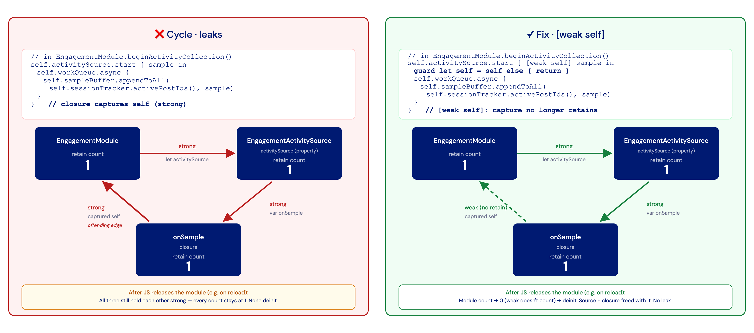
Who holds whom: our retain cycle
Notes:
This is the exact cycle Leaks drew, now shown with the app's own objects, and the clearest way to read it is as one question, who holds whom. The EngagementModule holds activitySource, which is its property. activitySource holds the onSample closure, which is its property. The closure captured self, so it holds the module right back. That is a closed loop of strong references.
Reference counting frees an object the instant its count hits zero, but every object here is held by another in the loop, so no count ever reaches zero. Even after JavaScript drops the module on reload, the three keep each other alive, and that is the leak. The fix is one word, weak self in the closure, which stops the closure from counting toward the module. Now when JavaScript releases the module its count falls to zero, it deinitializes, and the source and closure go with it.
Two details are worth explaining because they look like they might reintroduce the leak and do not. First, the fix unwraps the now-weak self once at the top of the closure with a guard, because making self weak makes it Optional, and the body uses self several times. If it is nil the closure simply returns, and if it is alive you get a normal self for the rest of the body. That unwrapped self is a local temporary that lives only while the closure runs and is gone the moment it returns, so it does not bring the leak back. What stays stored is still the weak capture, so between calls nothing keeps the module alive. Second, on the why of the shape: the textbook cycle has two boxes, but here there is an intermediate object, the source, sitting between the module and the closure it owns, which is the same principle with one extra hop. Only one edge in a loop needs to become weak to break it, and weakening the capture is the right edge because the module owns the source and the closure, not the other way around. weak is preferred over unowned here because it becomes nil safely if the module is already gone, whereas unowned would crash if accessed after deinitialization.

Slide 41
LeakCanary: a tool that makes leak hunting easy
Notes:
LeakCanary is the Android counterpart to the manual Instruments hunt done on iOS. Where iOS required reading the cycle by hand, LeakCanary does the equivalent hunt for you, automatically, in your debug build.
Out of the box it catches Android objects that were destroyed and should be gone but are still retained, such as Activities, Fragments, Fragment views, and ViewModels, and you can add your own objects to the watch list. The mechanism is straightforward. Once a watched object should be dead, LeakCanary keeps only a weak reference to it, waits, triggers a collection, and if the object is still in memory it is considered retained. It then dumps the heap, analyzes it, and hands you the leak trace, which is the shortest strong reference path from a GC root down to the leaking object. That trace is the retainer chain, the same idea as the Perfetto retainer graph, except LeakCanary finds it and explains it for you. It runs periodically as you use the app and posts a notification with the full trace.
It also exposes an API you can drive yourself. Calling watch on any object asserts that it should be collectable, which is useful for auditing your own controllers, listeners, caches, and presenters, not just framework types. You can wire the same check into instrumentation tests so the build fails when something leaks, turning a memory audit into a continuous-integration check rather than a one-off. It is debug-only and a no-op in release, and starts with essentially zero configuration beyond adding the dependency. The analysis engine underneath is Shark, which computes the leak trace from the hprof. One limit worth knowing is that it needs a Java or Kotlin retainer chain, so it will not catch native leaks the way a Perfetto heap dump can. For lifecycle and listener leaks it is the fastest signal available, and the bug in this demo is exactly that, a lapsed listener that stays registered after its owner is destroyed.
Further reading: LeakCanary, square.github.io/leakcanary

Slide 42
Does our module leak on destroy?
import leakcanary.AppWatcher
class EngagementModule : Module() {
override fun definition() = ModuleDefinition {
Name("Engagement")
OnDestroy {
stopFlushLoop()
// ... existing teardown ...
// After destroy this module should be
// collectable. LeakCanary checks that
// on its own, or dump the heap by hand
// from the LeakCanary app on the device.
AppWatcher.objectWatcher
.expectWeaklyReachable(
this@EngagementModule,
"EngagementModule destroyed"
)
}
}
}
LeakCanary also exposes an API.
In OnDestroy we assert: this module
should be collectable now.
If not, LeakCanary reports it.
Notes:
This shows the API side of LeakCanary, used as a deliberate audit rather than waiting for an automatic catch. In the module's OnDestroy, after everything is torn down, you hand the module instance to LeakCanary by calling expectWeaklyReachable on its object watcher with the instance and a short reason.
The meaning of expectWeaklyReachable is a claim. You are asserting that this object should become weakly reachable soon, in other words that it should be collected. LeakCanary keeps a weak reference, waits, forces a collection, and if the object is still strongly held that is a leak, at which point it dumps the heap and gives you the retainer chain. This is a precise memory audit. Rather than waiting to stumble on a leaked Activity, you pin down one object you care about and prove it dies. To try it you add the import and the call at the end of OnDestroy, run in debug, open the screen that creates the module, and then destroy it by navigating away or reloading. If it leaks, the notification carries the leak trace down to the module.
One Kotlin detail is worth flagging. Inside the Expo module definition and the OnDestroy block, plain this refers to the definition builder, so you pass this at EngagementModule to mean the module instance itself. The dependency for this API-only use is the object-watcher artifact, which has no UI. You can also dump on demand from the LeakCanary app on the device rather than waiting for the automatic check. Once the leak is confirmed and the chain is read, the fix is to unregister or tear down the listener on destroy.
Further reading: LeakCanary fundamentals, square.github.io/leakcanary/fundamentals-how-leakcanary-works

